Slide 1
Interviewing tips

Slide 2
Ethnographic interviews
Synopsis of approach
Open ended interviews with a focus on storytelling and free flowing conversation
These interviews are with the customer / user group - often defined during problem framing
The interviews should happen in the context of the target activity
Should be based on the key themes in your framework for analysis
Relevance to project
Guidance
High degree of leverage: we will see most needs and activities that exist in the field
Allows collection of useful data in a relatively short amount of time
Can be used to build both understand the user and test prototypes
Interviewer should only ask open ended questions, continually asking the participant to provide concrete examples
Interview in teams of two - one person leads the discussion, the other takes notes
We made a movie about ethnographic interviewing: https://vimeo.com/1269848

Slide 3
A process for good ethnographic interviewing
Step 1
Step 2
Step 3
Build rapport
Narrative
Checking questions
Introduce yourself, share something about yourself, but make sure to move the focus to the participant.
This can take time, do not rush into the questions. Watch for their body language to relax before you move on.
Be charming, positive, and reassuring. It is important to care about the topic and the participant.
Prepare a set of themes to explore, not a list of questions.
Do not ask “what is your average day” instead ask “what happened the last time…”
Follow up by asking:
Can you tell me about?
Say more…
Why?
Go back to any points of conflict or inconsistency (based on your notes), probe for resolution or explanation.
Ask follow up questions on any topic that requires more detail or information.
Always look for:
Surprises
Conflicts
What is different than you thought?

Slide 4
Tips for conducting a successful interview
A good interview is a friendly conversation.
Avoid directive questions that lead respondents to answer in a particular way.
Ask open-ended questions to solicit as much information as possible
Find ways of drawing out quiet group members by asking them questions directly.
Take notes of what group members say and what they don’t say. Pay attention to non-verbal cues that might indicate confusion, for example.
Try to dig for stories, feelings, and emotion.
Ask ‘WHY?’ often.

Slide 5
Example interview protocol
Who is on the team? Not just names, but characteristics of each individual.
Describe a time that the team worked well. Why did this happen? What contributed to the success?
Describe a time that the team did not work well together. Why did this happen? What contributed to the challenge?
How does the team work together (how do you interact, assign and complete tasks)?
When does the team work together?
What are the main roles on the team?
What technology do you use?
How did you use your current space?

Slide 6
Clean data – daily debriefs
What did we hear and see?
What did we learn?
What are we going to do about it?
Observations:
Activities and behaviors
Insights:
Key drivers and design criteria
Actions:
Recommendations and solutions

Slide 7
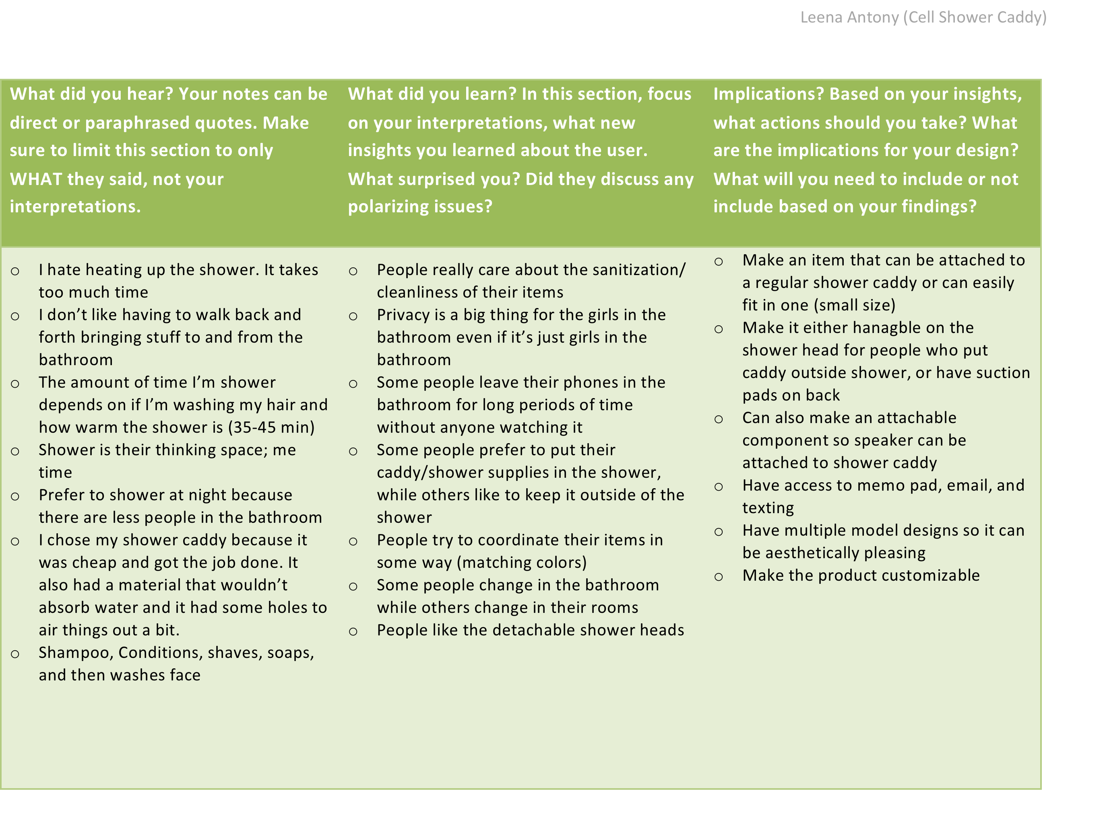

Slide 8
The empathy map

Slide 9
Build an empathy map for your users:
What are they:
Thinking
Feeling
Doing
Saying
…and what won’t they tell you?

Slide 10
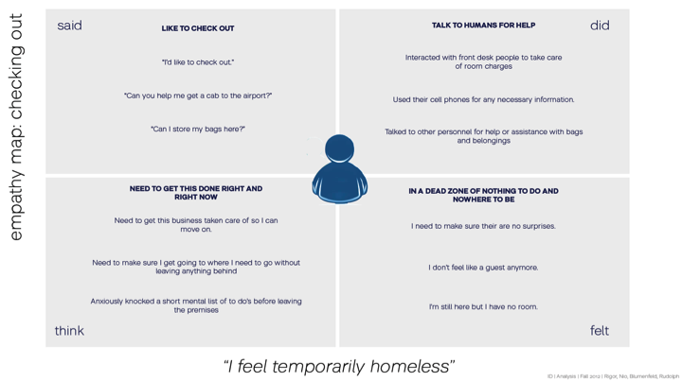
Example empathy map

Slide 11
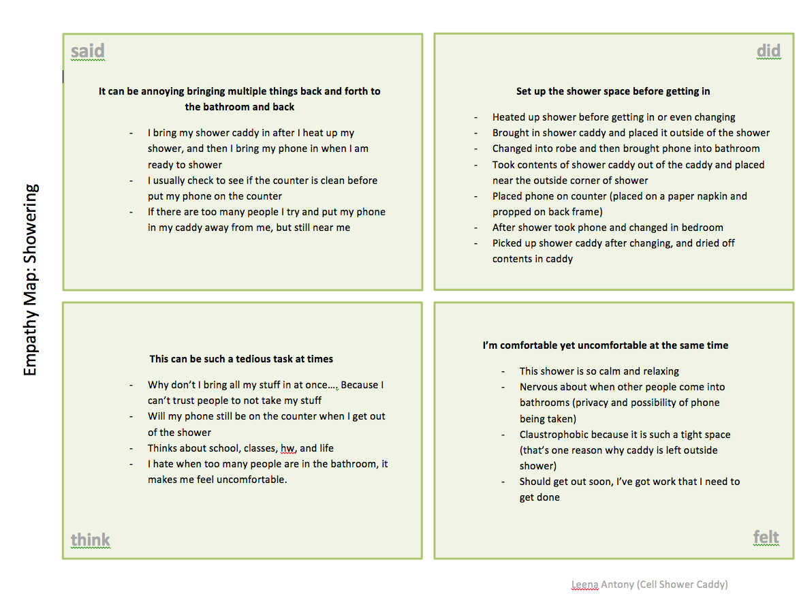

Slide 12
User journey

Slide 13
Understanding users: their journey
Depicts the user’s experience during a particular circumstance by showing:
People, places, and things
Activities
Emotions
Connections

Slide 14
Determine the relevant frame (from discreet activities to entire lifetimes…)

Slide 15
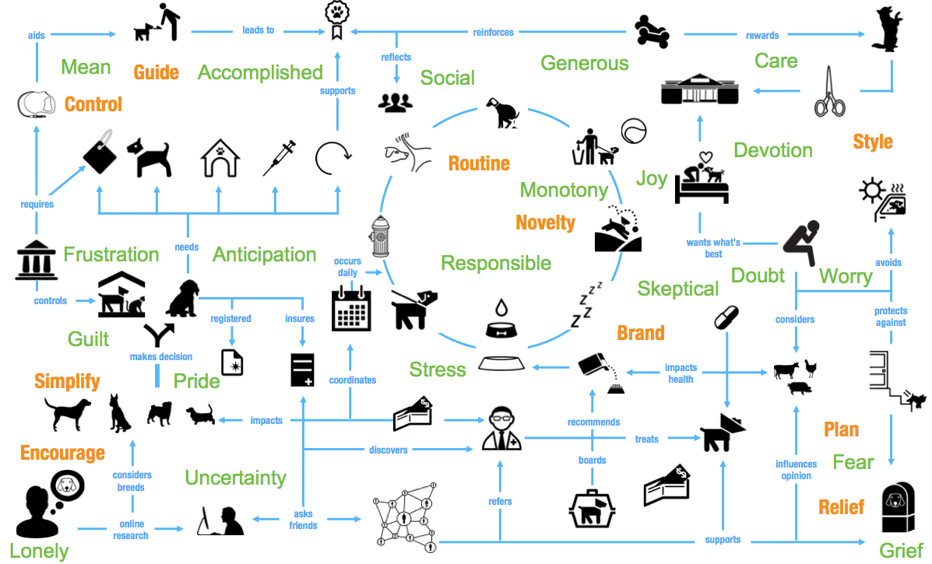
Complete the journey noting key people, places, things, activities, emotions, and connections:

Slide 16
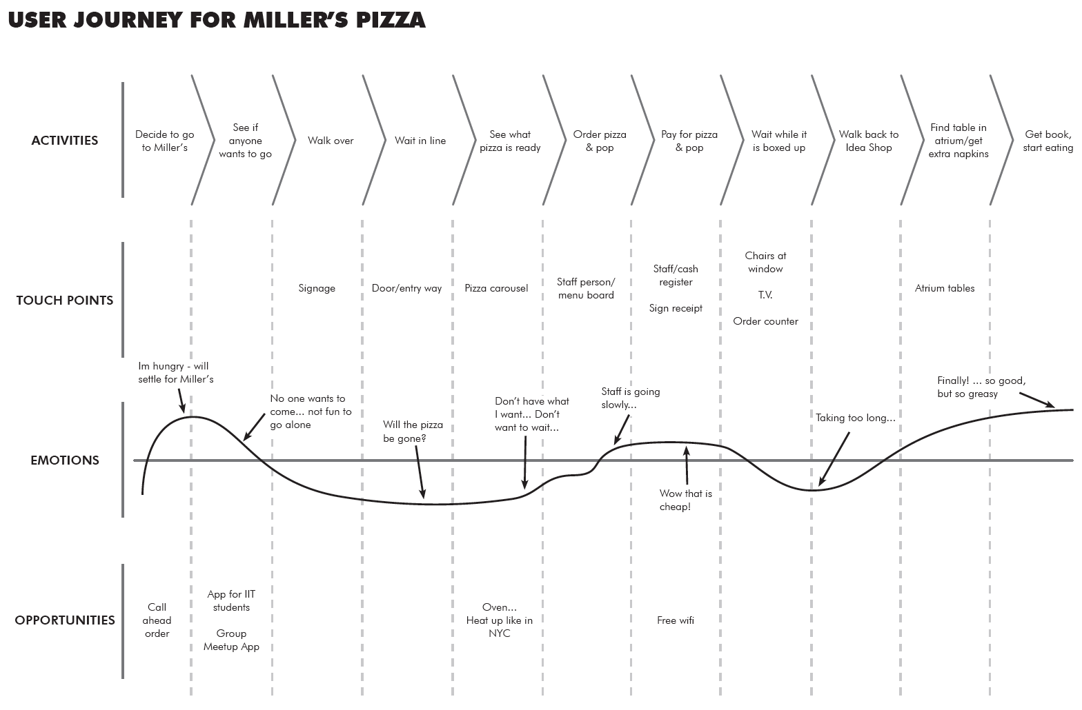

Slide 17
Our interpretations may entail multiple related dimensions:
Causality
“Why is it happening?”
Relation
“How does it connect?”
Significance
“Why does it matter?”
Meaning making
“What does this mean?”

Slide 18
